Slide 1
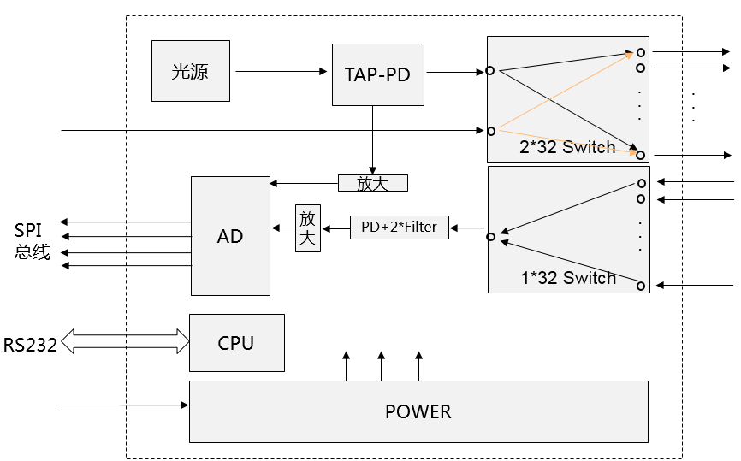

Slide 2
1x11 SW
SW2
 | Y+
X- | 1 | 2 | 3 | X+
 | 8 | C | 4
 | 7 | 6 | 5
 | Y-
Tap PD
2x3 SW
SW1
SW3
LD
SW4
P33
SW6
SW5
SW7
WDM
WDM
PD
1x3 SW
SW8
P33
1x11 SW

Slide 3
MT5-1
TX-01
1
MT5-12
1
SW2
(1x11)
SW6
(1x11)
RX-01
MT4-6
3
3
MT4-7
MT3-6
4
4
MT3-7
MT4-5
5
16
16
5
MT4-8
MT1-5
7
7
MT1-8
MT2-4
8
8
MT2-9
MT1-4
10
Tap PD
10
MT1-9
MT2-3
11
11
MT2-10
MT1-3
12
12
MT1-10
MT2-2
14
4
TX-11
14
MT2-11
MT1-2
15
RX-11
SW1
(2x3)
15
MT1-11
TOSA
2
MT2-1
C
TX-12
1
MT2-12
1
SW3
(1x11)
SW7
(1x11)
RX-12
LC/PC
6
MT3-5
3
8
3
MT3-8
MT4-4
4
4
MT4-9
MT3-4
5
16
5
MT3-9
MT4-3
7
7
MT4-10
MT5-5
8
16
8
MT5-8
MT6-4
10
10
MT6-9
MT5-4
11
11
MT5-9
4
MT6-10
MT6-3
12
SW5
(2x3)
12
MT3-3
14
RX-22
2
WDM
WDM
TX-22
14
MT3-10
MT4-2
15
C
PD
15
MT4-11
5
1
RX-23
8
TX-23
1
MT3-11
MT3-2
SW8
(1x11)
SW4
(1x11)
MT4-1
3
3
MT4-12
MT3-1
4
4
MT3-12
MT2-6
5
5
MT2-7
MT1-6
7
7
MT1-7
MT2-5
8
16
16
8
MT2-8
MT5-3
10
10
MT5-10
MT6-2
11
11
MT6-11
MT5-2
12
12
MT5-11
MT6-1
14
RX-32
TX-32
14
MT6-12
15
15
RX-Loopback
TX-Loopback

